Slide 1
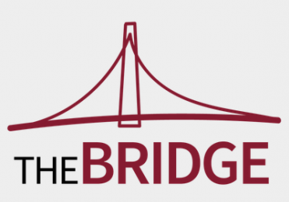
Are We Doing It the Right Way? The Impact of the Agency Selection Process on Client Public Relations Programs and Outcomes
Moderator: Jennifer Swint, Global President, Porter Novelli
Presenters:
Tony Cheevers, Vice President, Researchscape
Robert Udowitz, Principal, RFP Associates
Steven Drake, Principal, RFP Associates
Simon Erskine Locke, CEO, CommunicationsMatch™
#IPRBridge19

Slide 2
The Research
Methodology: online survey, distributed via survey links
Audience: internal lists including presenters lists, IPR, Holmes Report, CommPro, and social media
Field time: 6 weeks
Sample size: typical of response we see for narrowly targeted surveys, C-level executives at large brands
Next steps: survey agency audience to compare and contrast, only anecdotal data collected for this study

Slide 3
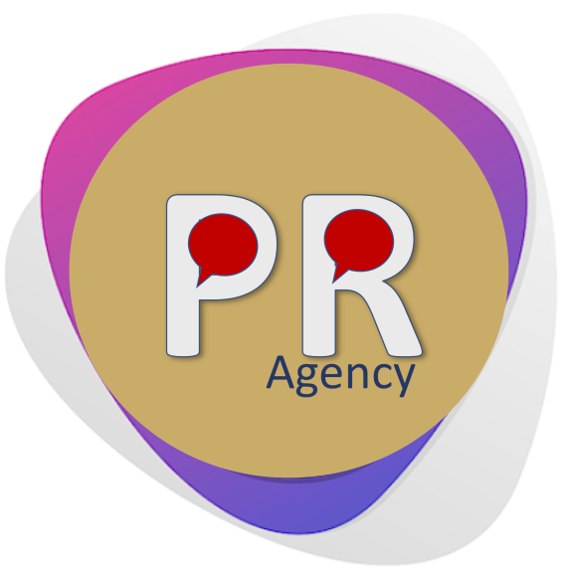
Typical Respondent
> 1/2 Publicly
Traded Companies
2/3 with Agency
Backgrounds
61% are VP, SVP or C-Level
73% have 20+ years of experience
Notes:
Our target respondents from the original planning stage of the survey were senior communicators at large companies and associations.
Add: 20+ years of experience (73%)

Slide 4
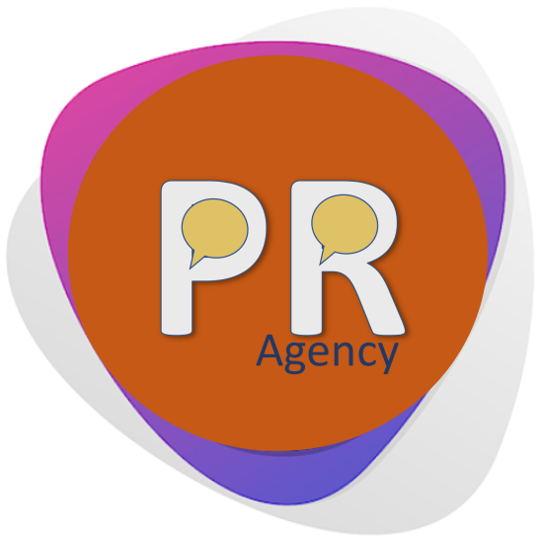
Typical Respondent
1/3 Work with ≥ 3 Agencies
Slightly under 30% paying >$1m annually for their primary agency
>75% would recommend their agency to others
Notes:
Our target respondents from the original planning stage of the survey were senior communicators at large companies and associations.
This slide should go after the agency search slide, and include the 75% recommend to others data point

Slide 5
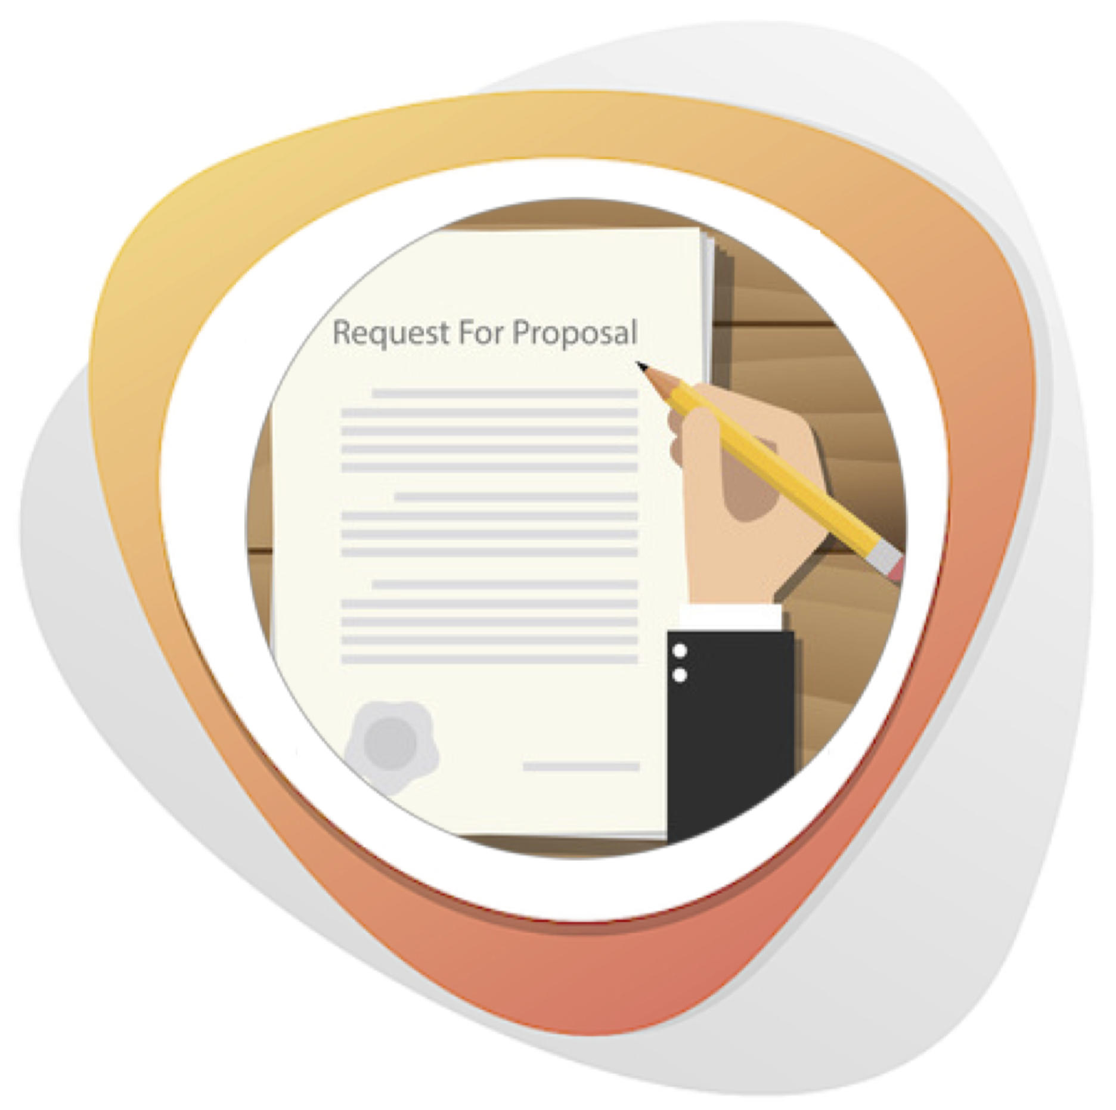
Typical Respondent
67% use an RFP to solicit agencies and 74% require formal presentation
Top criteria when seeking an agency:
Understanding our organization’s communications needs
Quality of strategic thinking
¾ search for an agency working with other departments
75% procurement
26% marketing
Notes:
Our target respondents from the original planning stage of the survey were senior communicators at large companies and associations.
Instead of word of mouth and number of agencies stat, how about instead: -- Utilizes formal RFP and presentation process and at the same time Cooperates with other business units (procurement, marketing)
Instead of recommend agency stat here, how about instead: “Very satisfied with method to identify and evaluate candidates”
73% - about ¾ - were either completely or very satisfied with

Slide 6
Typical Respondent
73% report being very or completely satisfied with the method used to identify and evaluate agency candidates
65% say: “we did a good job and have a great agency partner”
65% are very or completely satisfied with their agency selection

Slide 8
Clients: Peers, industry knowledge drive agency search . . .

Slide 9
. . . . yielding few initial agency candidates

Slide 10
Clients: RFPs utilized by 65%…
…but is the process comprehensive?

Slide 11
Clients: Generally satisfied with agency search and hire -- and their selected agency . . .

Slide 12
. . . but plenty of challenges cited . . . .

Slide 13
. . . particularly among executives with prior agency experience!

Slide 14
Clients: Takeaways and Recommendations
Agency utilization, budgets, satisfaction levels healthy
Agency search and evaluation:
Pre-screen more initial candidates – RFQ
Improve the RFP process – NDA
Dedicate more time, resources

Slide 16
Agencies: Phoning it In and Upselling?
Notes:
A better search process, focus on client needs, and selective approach to pitching, key to better outcomes
Phoning it in?
40% of companies see agency responses as boilerplate
Lazy or jaded?
Can I have some more please?
Upselling services is an issue for a third of respondents
If a company has defined what it wants and has defined a budget, is asking for more a good idea?
RFP responses often off-base
A question of unclear RFPs or proforma responses?
Agency or staff experience not aligned with projects
Scattershot approaches to pitching are a waste of time for all involved

Slide 17
Agencies: Annual Revenues for Primary Firms are Significant

Slide 18
Agencies: Better Compensated Draw Lower Satisfaction
2.8%
13%
43%
50%
36%
25%
14%
13%

Slide 19
Agencies: Compensated <$500K Draw Higher Satisfaction Ratings
75%
88%
60%
75%
67%

Slide 20
Agencies: Satisfaction
Good news and less good news
Two-thirds very or completely satisfied, one-third not so much
Key to client satisfaction is proactivity, account coordination, staff turn-over, meeting objectives, meeting budget and deadlines
Responses to RFPs must avoid boilerplate language and focus on customization - and avoid the upsell
Notes:
A better search process, focus on client needs, and selective approach to pitching, key to better outcomes
69% only moderately satisfied with proactivity,
44% meeting objectives

Slide 21
Q & A
Are We Doing It the Right Way? The Impact of the Agency Selection Process
on Client Public Relations Programs and Outcomes
Moderator: Jennifer Swint
Global President, Porter Novelli
Jennifer.swint@porternovelli.com
Presenters:
Tony Cheevers, Researchscape - tcheevers@researchscape.com
Robert Udowitz, RFP Associates – rudowitz@rfpassociates.net
Steven Drake, RFP Associates – sdrake@rfpassociates.net
Simon Erskine Locke, CommunicationsMatch™ - slocke@communicationsmatch.com
#IPRBridge19

