Slide 1

Your Strategic Marketing and Communications Partner
More than 15 years’ helping clients enhance brand recognition, generate qualified leads and grow their business.

Slide 2
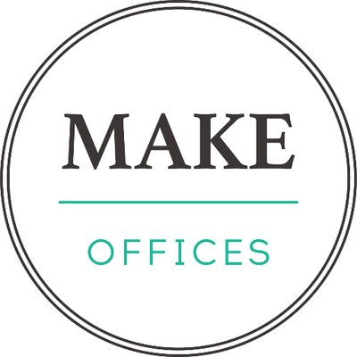
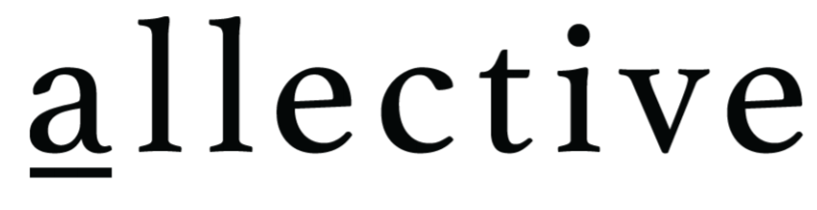


Our Approach
  We help our startup clients boost brand recognition, enhance credibility among key decision makers and influencers and help reach new, qualified customers to grow their business by developing and/or implementing integrated marketing, PR/communications, branding and social media strategies.
  A sampling of our early stage, angel or VC-backed clients include:

Slide 3
How We Work
Experts on-demand
  The strategic expertise of a virtual, fractional CMO/VP of Communications at ⅓ to ¼ the cost of hiring a CMO or VP
Outbound and inbound marketing and communications
  Director-level tactical marketing, communications, branding and social media expertise at the cost of an administrative assistant
Performance-driven
  Add value by driving brand exposure, generating qualified leads, increase closing ratios, and helping BD teams close new business
Flexible model
  Services delivered month-to-month for a flat, fixed fee that can be cancelled with two weeks’ notice

Slide 4

Research & Strategy
Auditing and benchmarking existing marketing, PR, branding and social media efforts
Competitor research and analysis
Client and prospect surveys/interviews/focus groups
Employee surveys/interviews/focus groups
Setting SMART goals and objectives (specific, measurable, actionable, realistic and time-based)
Identifying KPIs and metrics
Determining tactics
Establish budgets
Developing timelines
Verasolve believes research is the foundation for a solid marketing, PR, branding and social media strategy.
We conduct client, competitor, prospect and/or employee research, then analyze the results in order to develop strategic, integrated plans, associated tactics, KPIs and metrics for measuring success or the need for course corrections.
Our expertise enables you to look at the big picture before making decisions about the details designed to position your company for growth.

Slide 5

Branding
Branding strategy
Branding workshops
Naming and tagline workshops
Messaging workshops
Logo development
Brand identity and style guidelines
Your brand communicates your company’s vision, values and key differentiators. It’s one of the most important components of your marketing and communications strategy.
Whether you’re re-evaluating your branding strategy, creating a new brand or jumpstarting an existing one, Verasolve works with you to uncover your company’s truths: your story, your reputation, your legacy.

Slide 6

Marketing
Marketing and GTM strategies
Messaging and UVPs
Websites
  Strategy, sitemaps, content, copy
Content
  Blogs, newsletters, whitepapers, videos
Collateral
  Capabilities statements
  Brochures and one-pagers
  Past performances/case studies
  PPT presentations
Campaigns
  Direct mail and email
  Drip marketing
  Lead and client nurturing
  Vertical
Events
  Seminars/webinars
  Tradeshows/conferences
Employer branding for recruitment and retention
  Employee surveys, testimonials, videos, testimonials, online reviews, newsletters, job postings, etc.
Measurement
  Benchmarking, SMART goals, KPIs, metrics
Verasolve works with you to create targeted marketing strategies tailored to your company’s goals and objectives.
We drive initiatives that showcase your company’s unique value proposition (UVP) to successfully compete in the marketplace – and even take market share from competitors.

Slide 7

Public Relations
Thought leadership/executive visibility
  Bylined articles
  Whitepapers and reports
  Media interviews
  Speaking opportunities
Media relations
  News releases/alerts
  Article/interview pitches
  Media kits
  Corporate social responsibility (CSR) promotion
Awards
Measurement
  Benchmarking, SMART goals, KPIs, metrics
Communicate your brand story and UVP to target publics by publicizing timely, newsworthy topics and events.
Leverage your best asset—the expertise of your company’s leadership and subject matter experts (SMEs).
We position your executives as thought leaders and “go-to” industry experts, and your company as the place to work, primarily through earned media –amplifying brand exposure, enhancing credibility and fostering trust among potential clients and employees.

Slide 8

Social Media
Strategy
  Platforms
  Posts/updates and/or ads
  Frequency/cadence
  Follows, likes, hashtags
  Content calendar
Platform set-up
Creation and/or enhancement of company page(s) and executive profiles
Content research and/or development
Training
Dashboard management, including analytics
Measurement
  Benchmarking, SMART goals, KPIs, metrics
We know the importance of strengthening relationships and turning strangers into clients.
An active, strategic social media presence works to both humanize and legitimize your company.
We help you magnify brand awareness, promote thought leadership and engage with target audiences by putting relevant, informative and educational content in front of important centers of influence and decision makers.

Slide 9
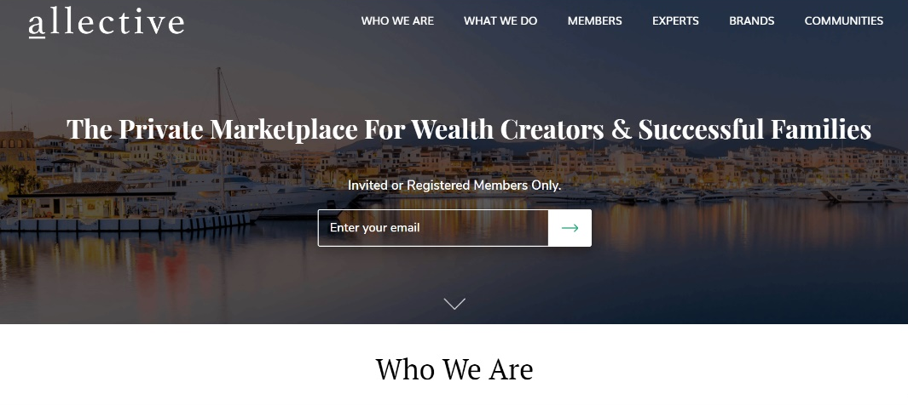
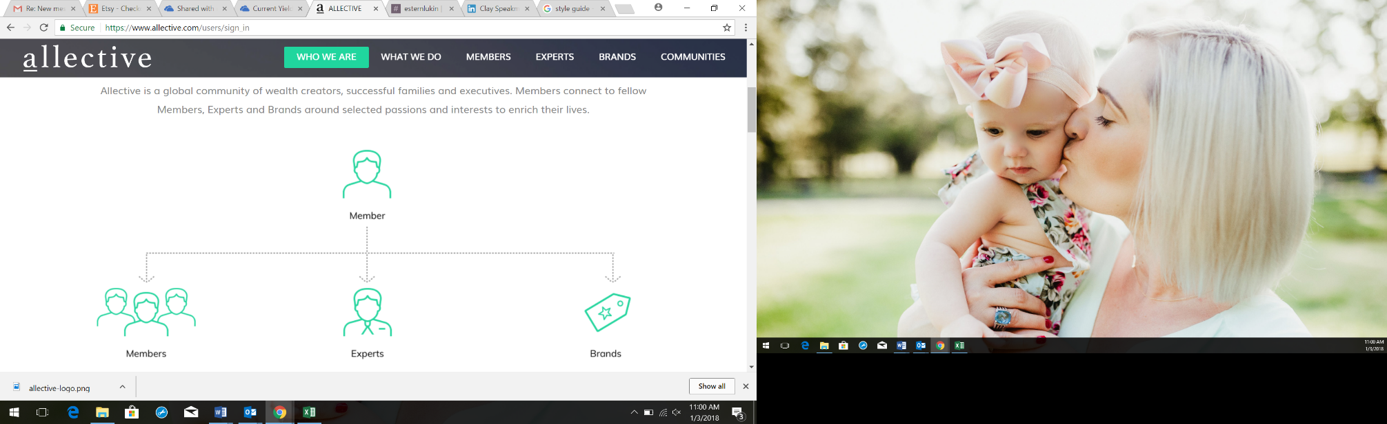
Success Story
Allective is a global community of wealth creators, successful families and executives.
Developed taglines and UVPs
Researched and recommended strategy for a new brand design
Provided creative direction for a redesigned website
Conducted a social media audit and created brand-aligned content
Created a style guide for consistent, on-brand materials, content and communications
Notes:
New website
Employee testimonials for employer branding
Complimentary collateral
Webinars

Slide 10
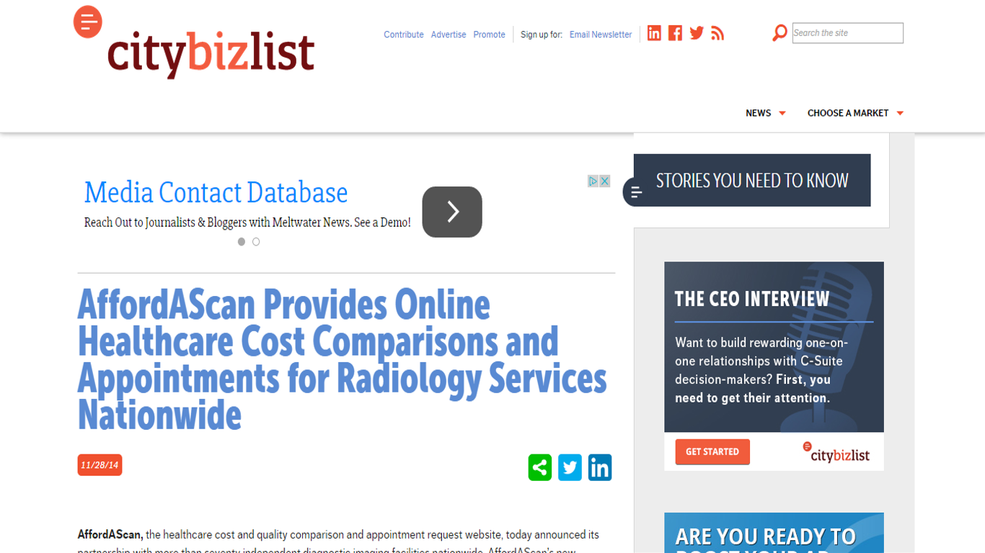
Success Story
ContactMyDoc
Developed core messaging and revised marketing collateral
Performed an in-depth website audit and strategic competitive research
Developed and executed a media campaign with new positioning to drive brand awareness nationwide
Successful campaign created new media relationships and enabled national recognition via top publications

Slide 11
Success Story
Developed taglines, brand positioning and new content
Conducted in-depth market research and developed the company’s UVP
Created and launched a themed promotional campaign, in partnership with humanitarian organizations in economically disadvantaged communities, called “Get One Give One”

Slide 12
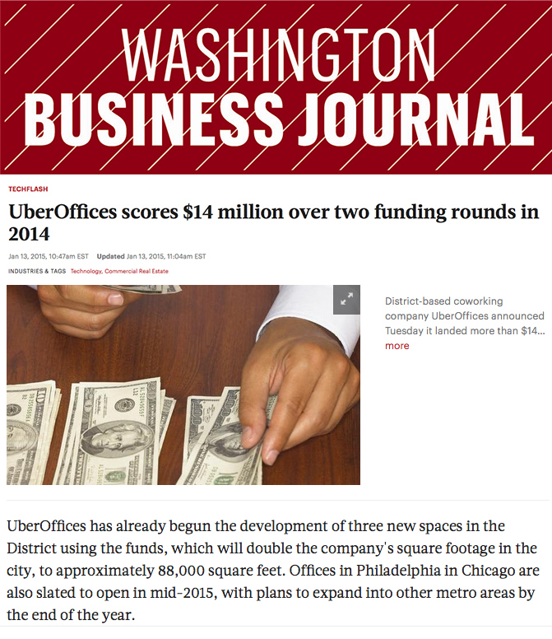
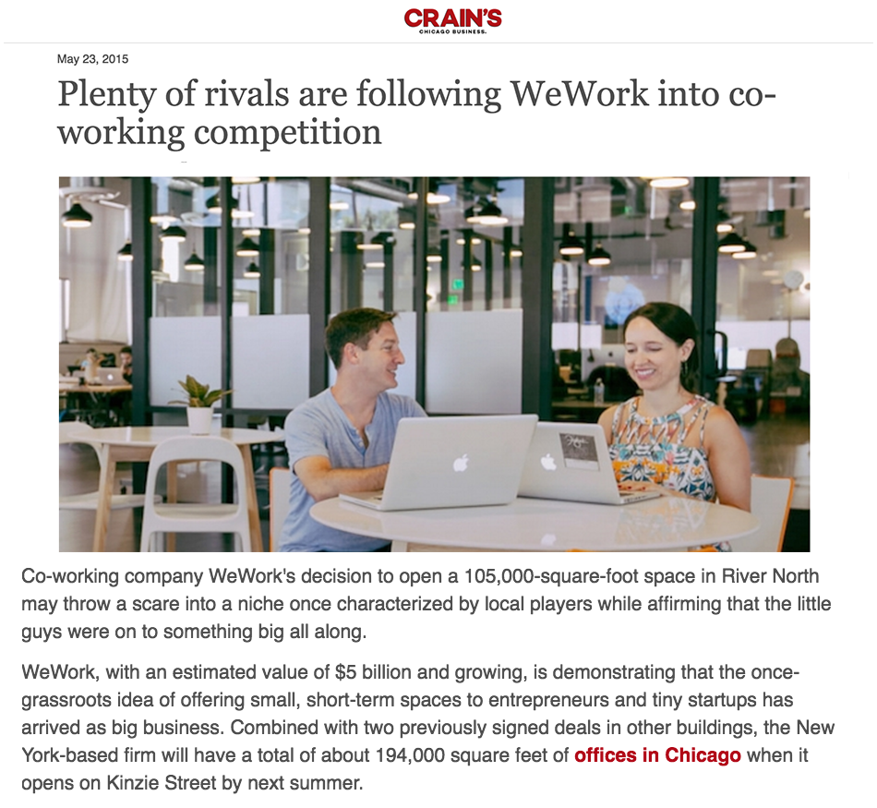
Success Story
Developed a comprehensive public relations strategy to increase brand awareness of MakeOffices (formerly ÜberOffices) in key target markets.
Earned top-tier media coverage:
  Crain’s Chicago Business
  Bethesda Magazine
  The Washington Business Journal
  SmartCEO
  Technical.ly DC

Slide 13

Virtual CMO/VP of Communications
Outsourced MarComm Support
Provide both strategic direction and execution
Develop comprehensive, integrated marketing and communications plans and tactics, along with SMART goals, KPIs and metrics
Focus on long-term goals, objectives and results and handling immediate needs or unexpected opportunities
Provide extra bandwidth when your in-house marketing and communications team is at capacity
Collaborate on execution and assessment of marketing and communications plans and tactics
Support your team during a product or service launch, rebrand or period of rapid growth

Slide 14
Questions?

Slide 15
Ethan Assal
ethan@verasolve.com
301.807.6390
www.verasolve.com

