Slide 1
Portrait Retouching Services | Family, Baby, Wedding, Fashion & Pregnancy Portraits
imageeditingagency.com

Slide 2
Portrait retouching services can be tedious as it takes hours to improve virtual makeup, provide facial reshaping, make over enhancing, color changing, natural teeth whitening, double chin deleting etc.
Also, take note that all skin deficits are fine-tuned in the most natural way. But we at ImageEditingAgency.com photo editing services do every you want for your Family, Baby, Wedding, Fashion & Pregnancy Portraits in just a quick turnaround time.

Slide 3
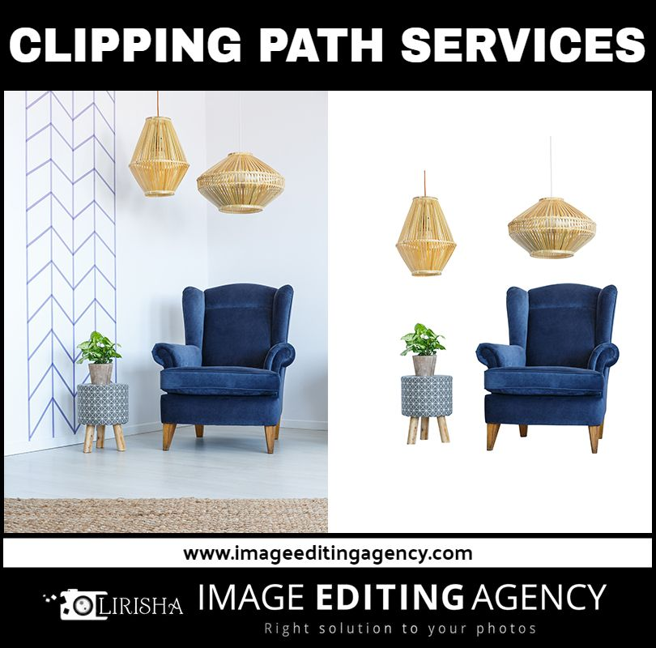

Slide 4
Who we are?
Family, Baby, Wedding, Fashion & Pregnancy Portraits Image Editing Services Online - Image Editing Agency. Image Editing Agency is the fast, quality, and affordable Portrait retouching & image editing service in the USA offering a complete range of professional photo Portrait retouching photo editing services for E-commerce agencies and product photography.
It also extends its service to background removal, background replacement services, and other image editing services to real estate Photographers, Digital Studios, Ad-Agencies and Business inclusive Clients of E-trade, Modeling Retouching, individuals, and more.

Slide 5
Instead of being a common portrait retouching, Our portrait retouching photo editing service expert design alluring and most impressive Family, Baby, Wedding, Fashion & Pregnancy Portraits for your special occasions or individual needs.
Our Exclusive Portrait retouching services include:
Photo Retouching Services, Photo Cut-out, Portrait retouching photo editing, Photo Portrait retouching photo editing Service, Edit Wedding Photos, Background Removal, Photo Restoration, Image Enhancement, Black and White to color and the perpetual rundown. Photo Manipulation, Product Photo Editing, Real Estate Photo Editing Services, Edit Background, Change Background, and more. Request for best Portrait retouching photo editing service @ imageeditingagency.com

Slide 6
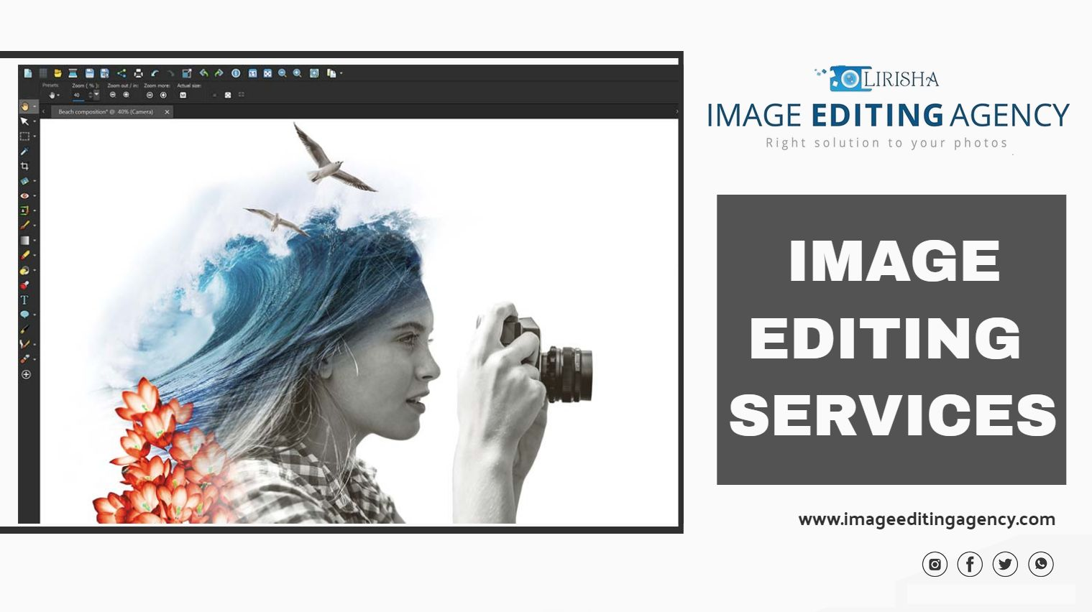

Slide 7
Why Choose Image Editing Agency for Quality Portrait retouching image editing services?
Quality:
Our team of excellent Portrait retouching photo editors knows portrait retouching done with poor quality and no attention to detail can hurt your reputation and your brand. Our business is built upon excellent Portrait retouching & image editing services that convert consumers and impress clients.
Time:
If you don’t have any time to spare, we’ll help you meet your tightest deadlines. We’ll provide fast quotes, speedy customer service, and quick results.

Slide 8
Price:
Affordable Portrait retouching & image editing services are what we’re known for, but that doesn’t mean our quality suffers. Whether you have one photo or a batch of thousands, you’ll have no trouble fitting our services in your budget.
Call Us For;
High-Quality Portrait retouching photo editing services, background removal, background replacement services.
Expertise & Dedicated Photoshop artists & Portrait retouching & image editing service
Get top-quality user experience with our 360 photo editor tool.
We help increase business sales with top-quality user experience.
24/7 Online Support Service.
Quick Turnaround Time.

Slide 9
Few More Words: How do we do Portrait retouching photo editing services?
Request a quote for the images you need editing, Receive an email with your quote in 45 minutes or less, Give us the confirmation to move forward with your project, Get your images in a short period of time, Sell lots of products and make your clients happy with the Image Editing Agency.
Finally:
Get High-quality Family, Baby, Wedding and Fashion & Pregnancy Portraits.

Slide 10
Upload your portrait images, get retouched and look prominent, impressive and visually appealing. Our portrait retouching caters to family portraits, baby portraits, wedding portraits, fashion portraits, pregnancy portraits, corporate portraits and more.
If you have any questions regarding our real estate image editing services, feel free to drop any comments. We would love to answer all your questions.
If you like to know more about photo Portrait retouching photo editing service in the USA, stay in touch with us on Facebook and other Social Media platforms. Still, thinking? Get your free quote now
Contact for more details: https://www.imageeditingagency.com

