Slide 1
Telling Stories In Sound and Images
The Lubetkin Media Companies LLC
Steve Lubetkin, MBA, APR, Fellow, PRSA
Managing Partner

Slide 2
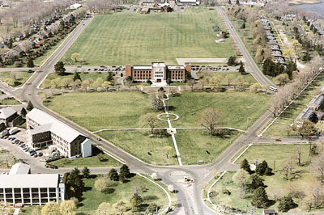
The Radio Bug Bites, Fort Monmouth, NJ

Slide 3
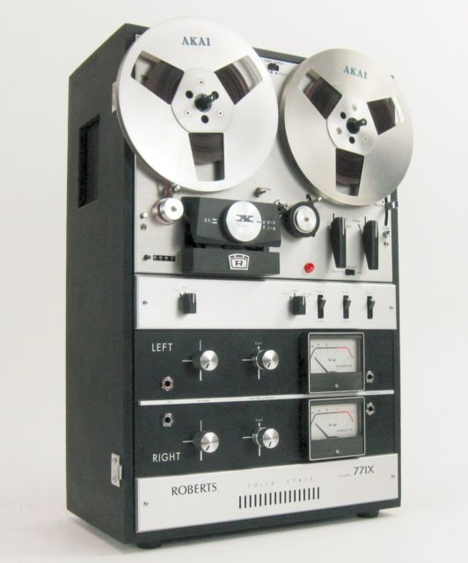
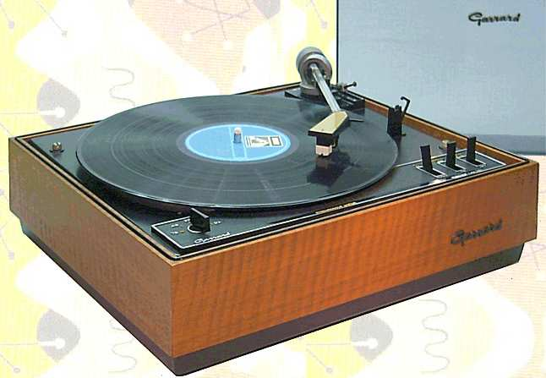
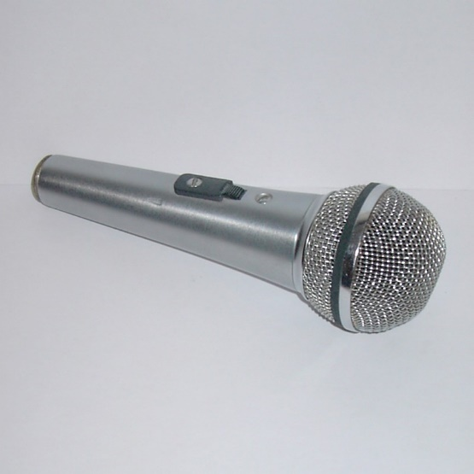
Podcasting in the 1970s

Slide 4
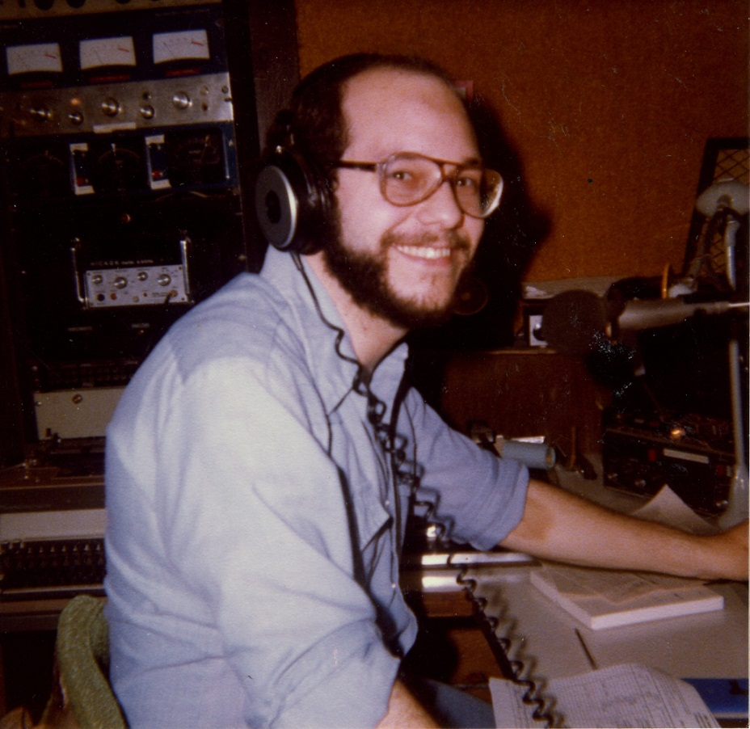
Working in Real Radio

Slide 5
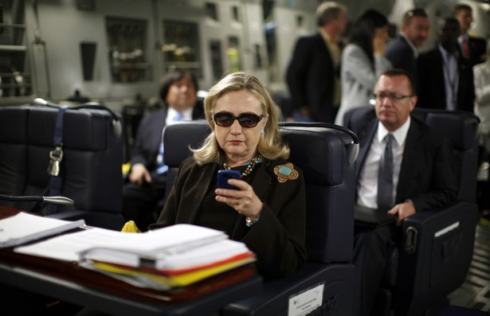
Myth: Boomers Don’t Use Technology

Slide 6
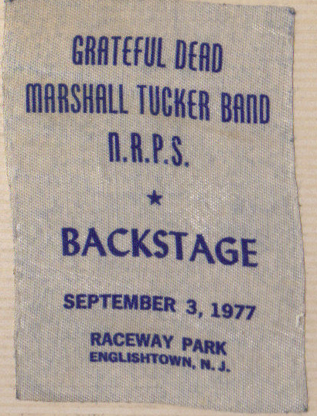
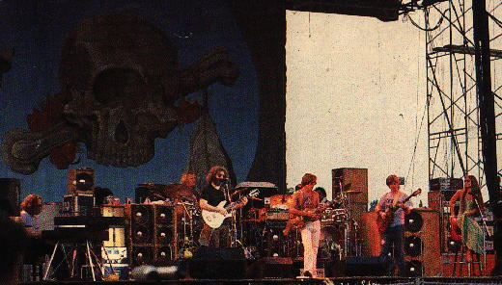
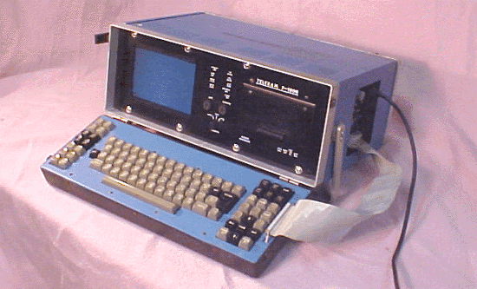

Slide 7
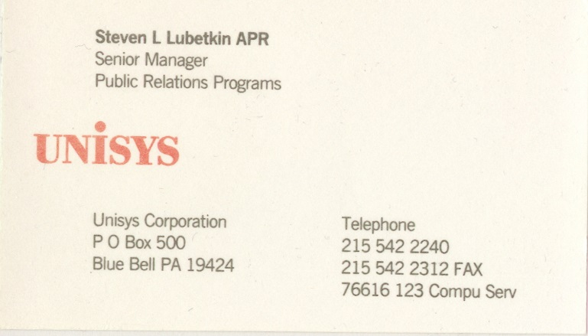
Email Address?
1988

Slide 8
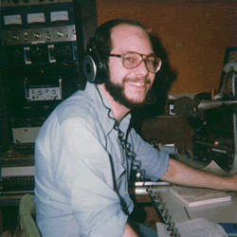
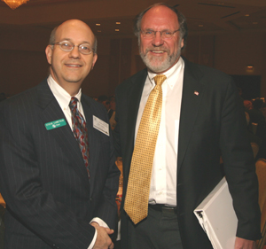
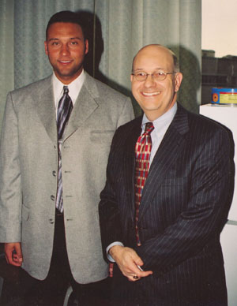
Our Background
Experienced radio production engineer and newscaster.
25 years in corporate public relations, including 15 years in financial services industry (Standard & Poor’s, Summit Bank, FleetBoston Financial, Bank of America)

Slide 9
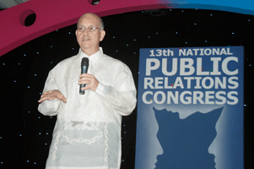
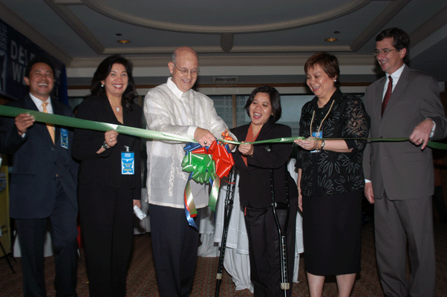
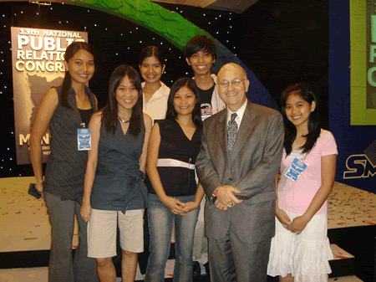
International Reputation
Steve is sought after as a speaker on this topic. He’s been to the State Department twice.
In September 2006, Steve was a guest of the US Embassy in Manila and the keynote speaker on podcasting and social media at the Public Relations Society of the Philippines

Slide 10
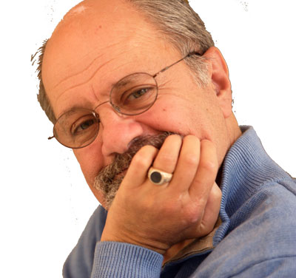
Our Clients

Slide 11
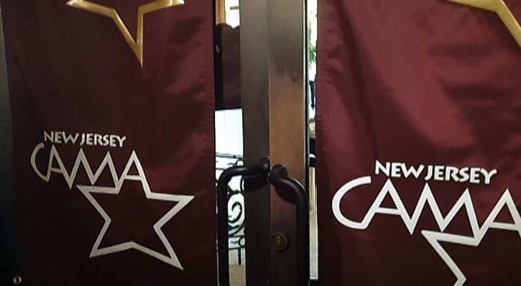
Recognized by Peers
Journalism awards for video from Society of Professional Journalists (NJ) and Garden State Journalists Association
Audio, video and web design awards from communications organizations

Slide 12
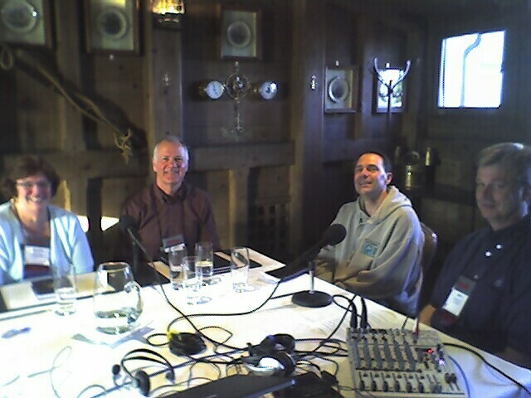
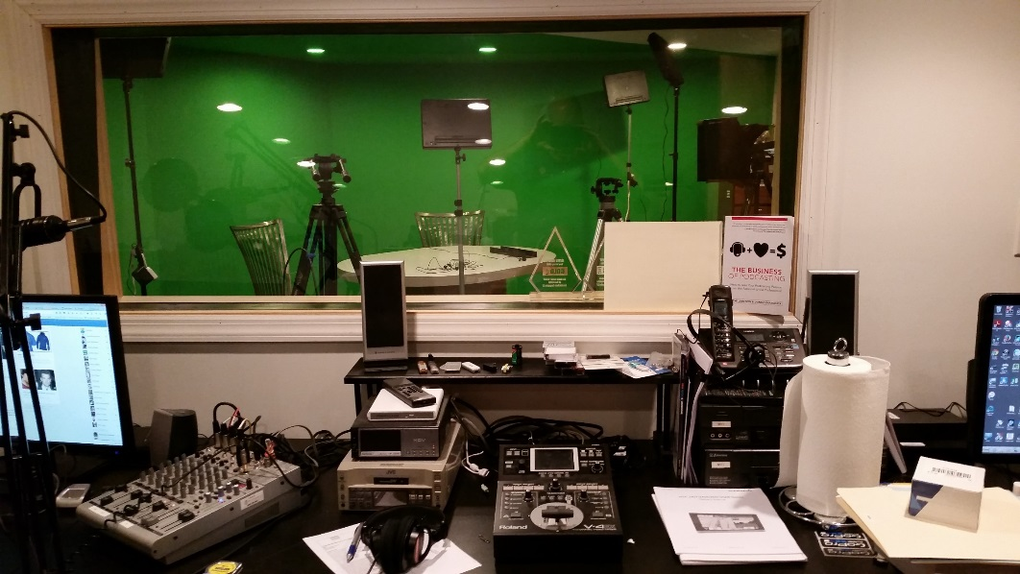
Audio Capabilities
Location recording in client’s office or at live events with multiple digital audio recorders, wired and wireless microphones
Post-production in our studios using the latest digital recording technologies, and royalty-free, licensed theme music.
Podcast studio at NAPL Top Management Conference
Delivery of programs in multiple file formats, including DRM protected content for clients wishing to sell programs.

Slide 13
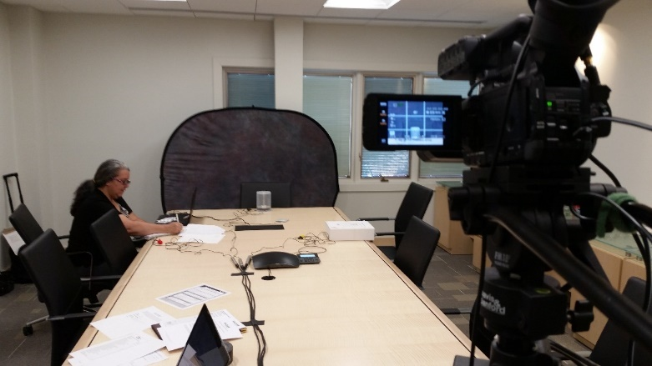
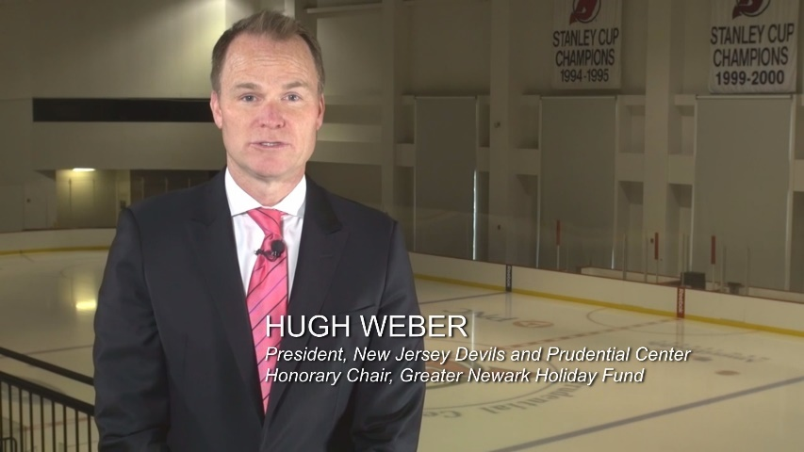
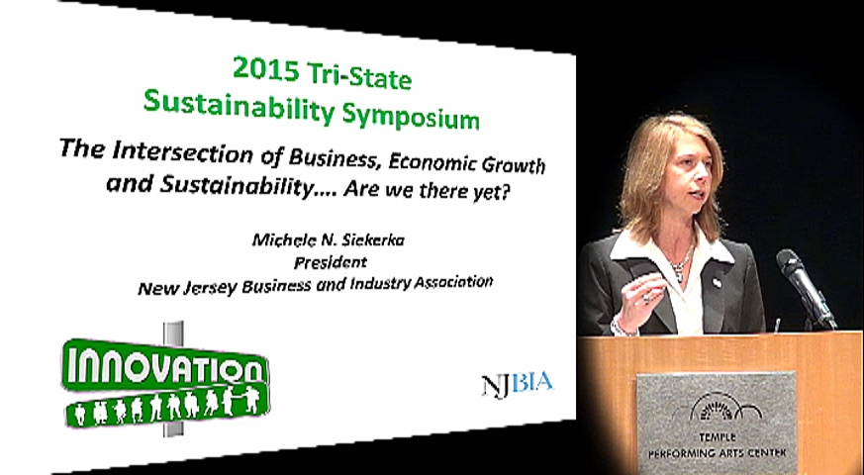
Adding Video to the Mix
Legal Deposition Videos
Public Service Videos
Seminar and Conference Videos

Slide 14
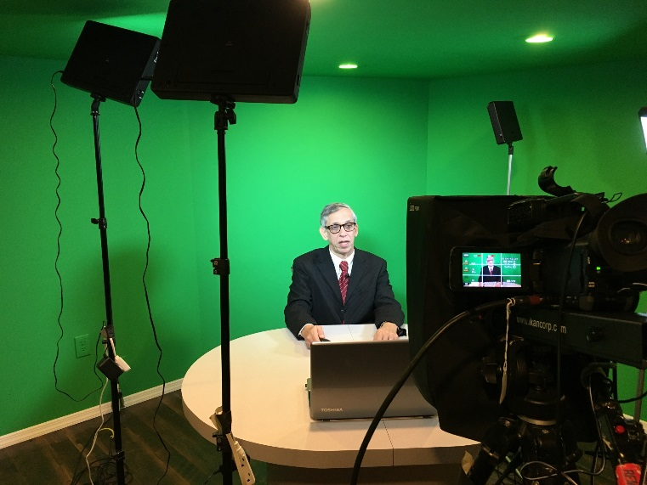
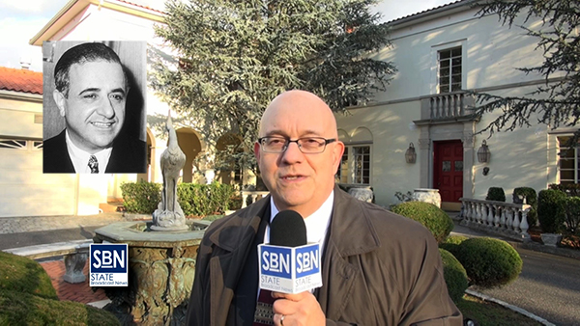
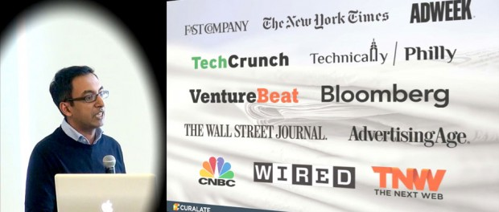
Video Capabilities
Professional HD Video Cameras
Live-switching of Multicamera Projects
News-oriented video reports
Documentary and tribute videos
Broadcast-quality post-production tools
Sophisticated Seminar Production

Slide 15
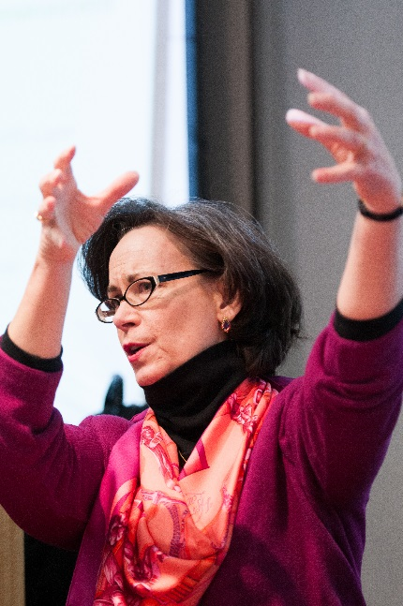
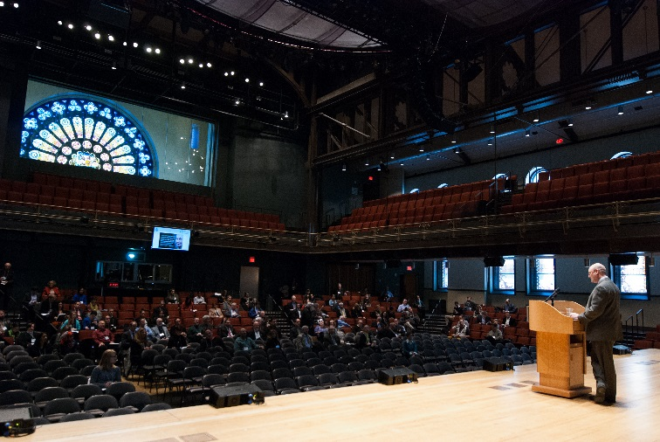
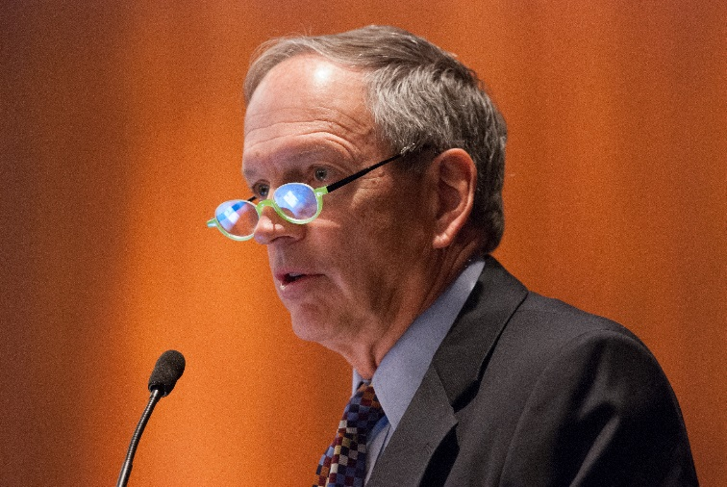
Corporate Photojournalism
Dramatic professional photographic images with a journalism flair for corporate and organizational needs

Slide 16
The Book
Kindle and Trade Paperback
http://bit.ly/bizpodamazon1
www.TheBusinessofPodcasting.com
@BizOfPodcasting
Facebook.com/thebusinessofpodcasting

Slide 17
Contact Us
Steve Lubetkin The Lubetkin Media Companies LLC
steve@lmediacos.com
856-751-5491 studio
856-625-5502 mobile
www.BeingTheMedia.com

